Slide 1
International Tax Law
Module V
Prof. Lorenzo del Federico

Slide 2
The transfer pricing system
Article 110, paragraph 7, TUIR takes into consideration transactions that take place within a transnational group and, more specifically, transactions between:
a) an Italian enterprise; and
b) a company not resident in the territory of the State, which either directly or indirectly controls the Italian enterprise, is controlled by it or is controlled by the same company that controls the Italian enterprise.
The foreign company can, therefore, be a parent, subsidiary or sister company of the Italian enterprise
What is deemed relevant for the purpose of applying transfer pricing regulations is the circumstance that a resident enterprise and a non-resident company are bound by a direct or indirect relationship of “participation in management, control or capital”

Slide 3
TP ratio
Article 110, paragraph 7, TUIR does not prevent prices from being freely agreed upon between the parties, but it does stipulate that the resulting income items must be measured, for tax purposes, according to the “arm’s length principle”.
The purpose of this provision is to prevent taxable items from being transferred from Italy to a foreign State by artificially fixing, as part of intercompany transactions, a consideration other than that which would have been agreed upon between independent entities under conditions of free competition. An Italian enterprise might, for example, have an interest in transferring profit to one of its foreign subsidiaries (perhaps to take advantage of lower rates or to allow the latter to offset past losses).
This could be accomplished in two ways:
a) by selling goods or providing services at a lower price than the price usually charged in transactions with third-party enterprises, i.e. by lowering revenues; or b) by purchasing goods or services at a higher price than the price usually charged by third-party enterprises, i.e. by increasing costs.
Such a conduct can be easily implemented in transactions between companies linked by controlling relationships, where setting a higher or lower price will generally not affect the group’s overall economic situation.

Slide 4
Transfer pricing and double taxation
Any upward adjustment of the intercompany price will risk giving rise to (economic) double taxation in the event that the tax authorities of the other State do not make a downward adjustment.
Similarly, if the authorities of the other State take the initiative and apply an upward price adjustment to the non-resident enterprise, the issue of (economic) double taxation will show up again if Italy does not apply a price adjustment to the resident counterparty as well.
To settle the matter, the former version of Article 110, paragraph 7, TUIR allowed the taxpayer to obtain a downward adjustment to its income, against an upward adjustment made to the income of a foreign affiliate, only in accordance with the agreements reached with the relevant authorities of the foreign State as a result of the special Mutual Agreement Procedure (MAP) set out in international conventions against double taxation on income .
At present, in the context of mutual agreement procedures, there is no real obligation for the authorities of the two States to reach an agreement to avoid double taxation. There is only a consultation requirement. Nothing else

Slide 5
Cost sharing agreements
Cost sharing agreements (CSAs) is a topic closely related to regulations governing transfer pricing.
This is a typical negotiating tool relied upon by multinational groups for the allocation of costs incurred centrally for the supply of services intended for the benefit of different group entities.
With regard to tax treatment, appropriately establishing the shares of the costs charged by the company performing centralised functions (usually the parent company) to the contracting subsidiaries is the most crucial aspect of cost sharing agreements. It is clear that, from a taxation perspective, such agreements raise issues quite similar to those related to transfer pricing, inasmuch as they can be exploited to cause wealth to be transferred from one State to another by allocating intentionally inflated costs

Slide 6

Check Point
What is TP ratio?
Why do TP rules apply in intercompany transactions?
Do you think is is easy to identify the arm’s lenghth price?

Slide 7
Controlled Foreign Companies (CFCs)
Article 167 TUIR covers a special tax regime applicable when an entity residing in Italy holds, whether directly or indirectly, a controlling interest in a foreign company located in a country or territory whose tax regime has significantly favourable aspects
The purpose of CFC legislation is to prevent Italian individuals who hold shareholdings in tax havens from deferring, possibly indefinitely, taxation on income produced by the foreign controlled companies (i.e. tax deferral).
Indeed, as is well known, income (earned by both individuals and companies) consisting of profits produced by foreign companies is taxed in Italy “on a cash basis” in the tax period of receipt thereof. By keeping income generated by (or through) a company residing in a tax haven, it would then be possible to delay taxation on such income. Precisely to avert this risk, a “transparency” taxation regime was also introduced for profits from shareholdings held in companies residing in tax havens
In addition to this, over the years the CFC tax regime has also been pursuing an anti-abuse purpose with a view to countering base erosion and profit shifting, a conduct that could be implemented by resorting to aggressive international tax planning, whose nominal level of taxation was less than 50 per cent of that applicable in Italy

Slide 8
CFC rule application
CFC rules will apply if the controlled foreign entities meet the following conditions:
a) they are subject to an effective level of taxation lower than half of that to which they would have been subject if they resided in Italy; and b) they earned income consisting, for more than one-third, of passive income, i.e. income from managing, holding or investing in securities, equity interests, claims or other financial assets, from the assignment or lease of intangible rights relating to industrial, literary or artistic property, as well as from the supply of services to entities that directly or indirectly control the non-resident company or organisation, including financial services.
If the prerequisites considered thus far are met, then the income earned by the foreign subsidiary will be ascribed, in the tax period underway as at the reporting date or as at the end of the period of operation of the foreign subsidiary, to the resident entities commensurate with their direct or indirect profit shares.
Article 167 TUIR stipulates that income earned by the foreign subsidiaries must be recalculated according to the rules applicable to resident entities in order that corporate income may be determined

Slide 9
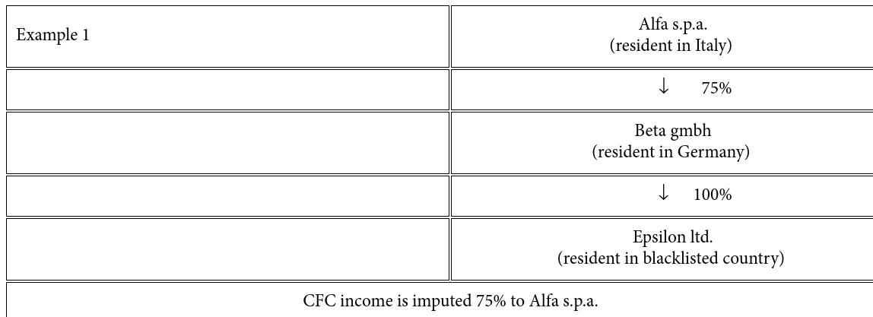
Example
To determine the profit share, in the case of an indirect shareholding, the scaling-down criterion will apply, except when the “intermediate” company is an entity residing in Italy

Slide 10
Disapplication of CFC rules
The application of CFC rules can be avoided proving that the non-residententity engages, in its own State – the conduct of a genuine business by using local personnel, equipment and assets
The taxpayer may file a tax ruling

Slide 11
Check Point
What is CFC rules’ ratio?
Which condition must be met for appying Italian CFC rules?
Can the taxpayer avoid CFC rule application?

Slide 12
Exit Tax
Article 166 TUIR regulates what is known as “exit taxation”, which applies when a resident person transfers their residence abroad → transferring abroad the tax residence, or part of the assets, entails the taxation in Italy of the capital gains arising from the assets and liabilities transferred.
There are five cases in which the aforesaid capital gains must be taxed. In particular, they concern natural or legal persons who carry on a commercial enterprise and who are either:
a) tax resident in the territory of the State and transfer their tax residence abroad; or
b) tax resident in the territory of the State and transfer assets to one of their permanent establishments situated abroad in relation to which the exemption of profits and losses under Article 168-ter applies; or c) tax resident abroad, have a permanent establishment situated in the territory of the State and transfer the entire permanent establishment to the head office or to another permanent establishment situated abroad; or

Slide 13
…
d) tax resident abroad, have a permanent establishment situated in the territory of the State and transfer assets forming part of the assets of that permanent establishment to the head office or to another permanent establishment situated abroad; or
e) tax resident in the territory of the State and have been acquired by merger by a non-tax resident company or have effected a spin-off in favour of one or more non-resident beneficiaries or have effected the transfer of a permanent establishment or a branch thereof situated abroad in favour of a tax resident abroad.
The taxable capital gain consists in the difference between the market value and the corresponding tax cost of the transferred assets and liabilities →taxable “exit” income equals the difference between the market value of the transferred assets and liabilities and their tax cost.

Slide 14
The ratio of exit tax
Such provisions trigger tax liability upon the occurrence of complex circumstances, such as the transfer of tax residence as well as the exclusion of business assets from the domestic tax regime in which they had previously been placed, thus contributing to the determination of taxable income.
This follows unequivocally from the fact that the mere transfer of tax residence has no effect if the assets are transferred to a permanent establishment and not subsequently diverted from it.
An exception is the immediate taxation of capital gains relating to assets forming part of a permanent establishment abroad, given that, due to the loss of tax residence and the lapse of the worldwide taxation principle, Italy would otherwise lose any and all future possibilities of levying tax in respect of such capital gains.
In other words, the rules in question seem to belong, at a systematic level, to the barriers set up by the tax legislator to prevent business assets from being diverted from the business without leading to the surfacing of items of income

Slide 15
Exit taxation and the principle of freedom of establishment
The compatibility of exit taxation with European law (in particular with freedom of establishment) has been discussed by the European Court of Justice
The Court held that national rules providing for the taxability in the “exit” country of unrealised capital gains upon the transfer of the seat abroad are not per se incompatible with the principle of freedom of establishment. At the same time, however, the Court held that legislation providing for the “immediate” collection of taxes on such capital gains was contrary to this principle. In other words, the Court of Justice held that, in the case of a transfer of seat within the European Union, the “exit” country—in application of the territoriality principle—retains the right to tax the difference between the market value and the tax value of the transferred assets, but collection cannot take place immediately, as this would constitute a restriction of the freedom of establishment

Slide 16
Entry Tax
The opposite phenomenon to exit taxation is governed by Article 166-bis TUIR
Entry Tax concerns, in general, persons coming from other States (i.e. acquiring Italian tax residence as a result of moving to Italy) and aims to regulate the valuation of “inbound” assets for the purposes of taxation in Italy and to correctly allocate taxing powers among the jurisdictions involved in the transfer
The value of the assets will contribute to the formation of the business income realised in Italy as a result of carrying on a productive or commercial activity (as deductible depreciation allowances, taxable capital gains, etc.)

Slide 17
Check Point
Why does Italy – as many other States – provide an exit tax?And an entry tax?
Why should a company pay for unrealised capital gains?
Do you think that exit taxation can be an obstacle for companies freedom of establishment within the EU context?

Slide 18
The foreign tax credit
Aware that the adoption of the worldwide taxation principle entails high risks of double taxation, the Italian legislator unilaterally recognised the taxpayer’s right to deduct foreign taxes from the Italian tax due on income earned abroad.
Subject, however, to one limitation: foreign taxes, provided they have been paid in full, are deductible up to the amount of tax corresponding to the ratio of income earned abroad to total income net of any losses from previous tax periods.
In addition, the deduction is not allowed in the case of failure to file tax returns or failure to indicate income earned abroad in the tax return filed
If there is income generated in several States, the deduction will be applied separately for each State.
Where a convention is in place, the credit method for foreign taxes provided for in domestic law is replaced by the similar method laid down in the convention

Slide 19
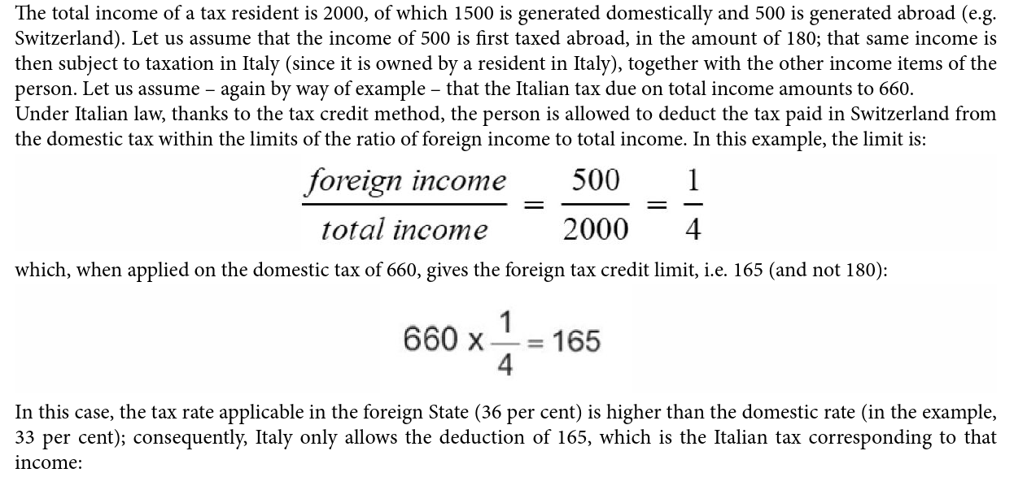
Example

Slide 20
European tax Law
Main features and principles

Slide 21
The EU legal framework
EU member States a rebounded not only to principles and obligations deriving from tre EU treaties but also to the acts that the institutional bodies (Parliament, Council and Commission) issue and that the Treaty on the Functioning of the European Union sets out in regulations, directives, decisions, recommendations, and opinions.
As of 1 December 2009, the consolidated versions of the Treaty on the Functioning of the European Union (TFEU or Treaty of Rome) and the Treaty on European Union (TEU or Treaty of Maastricht) are in force
Furthermore, Article 6 TEU:
• recognised the Charter of Fundamental Rights of the European Union as having the same legal value as the Treaties ;
• provided for the accession of the European Union to the European Convention for the Protection of Human Rights and Fundamental Freedoms (ECHR);
• stated that fundamental rights, as guaranteed by the ECHR and as resulting from the constitutional traditions common to the Member States, constitute general principles of EU law.

Slide 22
While the ECHR has legal force in the Italian legal system since 1955, also by virtue of having been ratified and implemented (see what has been discussed in Chapter I with regard to the prevalence of conventional norms over domestic law, given their nature of “interposed norms”, pursuant to Article 117 of the Italian Constitution), the EU Charter of Fundamental Rights acquires legal force by virtue of its “transposition” into European law, thus gaining—as mentioned—the same value as the EU Treaties.
Article 6 TEU, however, explicitly states that the provisions contained in the Charter shall not extend in any way the competences of the Union as defined in the Treaties. Both the Court of Justice of the European Union and the Italian Constitutional Court have therefore ruled out that the Charter constitutes an instrument for the protection of fundamental rights beyond the competences of the EU. In other words, a requirement for the applicability of the Charter is that the case before the court is regulated by European law

Slide 23
EU law relevance
How do EU acts fit into the legal systems of the Member States?
After quite a few years of resistance on the part of some national courts—primarily constitutional ones—there has been a general acceptance of the principles expressed in this regard by the CJEU, namely that:
directly applicable European Union rules (in the terms set out above with regard to the different types of EU sources), which may therefore be relied upon by individuals and companies before national courts, prevail over previous and subsequent national law, including constitutional law
such primacy is imposed not only on the Member States but on all their bodies, and it operates through the disapplication of conflicting domestic rules and the application of EU rules by national courts, as well as all administrative bodies, including local authorities

Slide 24
The primacy of EU law
With regard to the preliminary rulings of the CJEU under Article 267 TFEU, they have the direct effect of binding the national referring court to comply, in deciding the specific case, with the solutions to the questions of law contained therein. Moreover, as stated by the Court, they are effective erga omnes
In addition to the interpretation of EU law, the CJEU has jurisdiction to issue preliminary rulings on the validity of the acts of the EU institutions and the European Central Bank, as well as on the interpretation of the statutes of the bodies created by an act of the Council, when so provided in the statutes. The direct effect in domestic law of an EU rule endowed with such force also applies to the decisions that refer to such rule contained in the preliminary rulings of the CJEU.
The Italian Constitutional Court came to the same conclusions concerning the primacy of EU law over national law on the basis of the constitutional provision contained in Article 11 of the Italian Constitution, according to which Italy agrees, on conditions of equality with other States, to the limitations of sovereignty that may be necessary to a world order ensuring peace and justice among the nations, also promoting and encouraging international organisations furthering such ends.
According to the Constitutional Court, the law implementing the Treaties establishing the European Communities brought about, in application of the aforementioned constitutional provision, a retraction of the national legal system in the context of a transfer of sovereignty and a substitution of Community competences for State competences.
The amendment to Article 117 of the Constitution now enshrines the principle that the legislative powers of the State and the Regions shall be exercised in compliance with the constraints deriving from EU legislation and international obligations
Of course, the primacy of EU law works also in the tax field

Slide 25
Check Point
What does the primacy of European law mean?
Can you imagine the consequences of such a principle?
Think about a tax field «covered» bu EU law, such as VAT. Do you think it is possible for Member States to apply VAT differenty from EU VAT Directive?

Slide 26
Tax matters in EU
Tax matters are seldom directly referred to in the Treaty on the Functioning of the European Union. Many of such references relate to achieving the goal of creating a single market without internal frontiers, in which the free movement of goods, persons, services and capital is ensured (Article 26 TFEU).
This is the approach of the provisions included in Articles 28 et seq. TFEU which, on the one hand, prohibit between Member States customs duties on imports and exports and of all charges having equivalent effect and, on the other hand, provide for the establishment of a customs union between those States and the adoption of a common customs tariff.
In this area of primary importance for the European Union, not least because the revenue from customs duties is allocated to its budget, action is taken by means of regulations directly applicable in the Member States’ legal systems (see, for example, Regulation (EU) no. 952/2013 which contains the Union Customs Code).
Articles 110, 111 and 112 TFEU reflect the logic to ensure the free movement of goods. Such Articles prohibit Member States from adopting national tax measures that discriminate against products from other Member States in comparison to domestic products, as well as from subsidising products intended for export to other Member States by granting tax refunds in excess of the domestic taxes actually paid, subject to exceptions—in the case of charges other than turnover taxes, excise duties and other forms of indirect taxation—approved in advance bu the Council.

Slide 27
Harmonisation
Article 113 TFEU does not lay down direct prohibitions, but requires that the Council, acting unanimously (on a proposal from the Commission and after consulting the European Parliament and the Economic and Social Committee), adopt provisions for the of legislation concerning turnover taxes, excise duties and other forms of indirect taxation to the extent that such harmonisation is necessary to ensure the establishment and the functioning of the internal market.
Harmonisation is ordinarily pursued through the adoption of directives, which Member States undertake to transpose into their legal systems within the agreed deadline, although the Article in question leaves open the possibility of adopting other acts, including regulations. This is the context pertaining, for example, to Directives 67/227/EEC and 67/228/EEC of 11 April 1967 (better known as the First and Second Directives) on the adoption of VAT as a common turnover tax, subsequently absorbed by Directive 77/388/EEC of 17 May 1977 (the Sixth Directive), which was in turn incorporated into Directive 2006/112/EC of 28 November 2006, containing the so-called “recast text

Slide 28
A glimpse to the legal framework
At present, the legal framework is rather complex, as:
there are taxes regulated at EU level by regulation (e.g., customs duties, whose uniform regime is fundamental for the implementation of the single European market);
taxes harmonised by directive (VAT);
taxes that are not harmonised or only partially harmonised with regard to specific aspects of EU relevance (e.g., corporate income tax, which is harmonised by directive with respect, for instance, to the regime applicable to extraordinary cross-border transactions).
It goes without saying that, while EU law is directly relevant for harmonised taxes (since the matter is regulated directly by the EU legislator), it can only be indirectly relevant for non-harmonised taxes, meaning that the domestic regulation of these taxes, although freely determined by the national legislator, cannot affect fundamental freedoms (free movement of goods, persons, services and capital) and be contrary to general EU principles (in particular, the prohibition of discrimination and the prohibition of State aid).

Slide 29
State Aids
A subject of great relevance under EU law is undoubtedly that of State aid regulation.
Article 107 TFEU contains a detailed set of rules on this point, mainly aimed at protecting one of the main objectives of the EU, namely the need for an efficient system of competition within the common market.
State aids can be defined as those measures consisting of public interventions which grant certain undertakings or the production of certain goods an economic advantage—usually a reduction in the costs incurred—that may affect the conditions of competition.
Article 107 TFEU prohibits such aid if it affects trade between EU Member States: “Save as otherwise provided in the Treaties, any aid granted by a Member State or through State resources in any form whatsoever which distorts or threatens to distort competition by favouring certain undertakings or the production of certain goods shall, in so far as it affects trade between Member States, be incompatible with the internal market”.

Slide 30
The characteristics of non-compatible aid, therefore, are:
selectivity, i.e. the aid favours certain undertakings or certain productions;
advantageousness, i.e. the aid tends to cause a decrease in costs (or other economic advantage) in favour of the beneficiary;
public origin, i.e. the aid is financed through public resources;
relevance, i.e. the aid affects trade in the EU.
Typical examples of State aid are tax and social security reliefs granted to undertakings in a certain sector

Slide 31
Check Point
What is Harmonisation?
Why EU law could be indirectly relevant for non-harmonised taxes?
Ehat are State Aid and which is their ratio?

