Slide 1
TAX LAW
Module III
PROF. LORENZO DEL FEDERICO

Slide 2
OUTLINE
Exempt income: dividends
Deductions: the case of interests
Incentives
The patent box regime
Depreciation tecniques
Selected tax incentives for tax planning purposes

Slide 3
Exempt income
In Germany, the most important types of exempt income are
- at the company level, capital contributions upon formation or capital increase, whether or not in return for shares, other membership rights or simply in connection with an increase in the capital reserves;
- at the shareholder level, capital repayments from the company if they do not contain dividend distributions (taxable to the extent they exceed the book value of the shareholder’s investment); and
-qualifying dividends and capital gains
In most countries, the main item of exempt income is “qualifying distributions” (e.g. dividends)

Slide 4
Deductions: general features
In general, duly substantiated expenses incurred for the purpose of acquiring and preserving taxable income are deductible.
In Germany, the taxable income of corporate taxpayers is the total amount of income whether from domestic or foreign sources after deduction of business expenses. Dividend payments, as opposed to interest and royalties, do not constitute deductible expenses. Restrictions concerning the deduction of business expenses exist in particular with respect to outlays for personal expenses (gifts, guest houses and the like), all types of dividends and taxes qualifying as taxes on persons.
In Spain, business-related expenses are deductible for corporate income tax purposes. Non-deductible items include dividends and similar distributions, the income tax itself, penalties and fines and related surcharges, certain expenses paid to residents in listed tax havens, unless duly substantiated, and all gifts except those to qualifying donees. Allocations to provisions set aside for the coverage of environmental expenses are deductible, subject to prior approval by the tax authorities
In UK, expenses are generally deductible in computing trading profits, provided that the expenses are of a revenue (i.e. not capital) nature, and that they are wholly and exclusively laid out for the purposes of the trade. Also, they must not be such as are disallowed by statute. Dividends are not deductible, whereas, generally, interest and royalty payments are deductible. However, certain payments of interest and royalties may be classified as dividends for tax purposes
In Italy, as a general rule, costs and expenses may be deducted only if they are incurred for the production of income. This rule does not apply to certain deductible items, such as interest paid and social security contributions. The deduction of business expenses is allowed on an accrual basis, with some exceptions (e.g. directors’ fees, deductible on a cash basis). Costs and other expenses are deductible in the fiscal year in which they are certain or ascertainable.
Also in France, in general, expenses related to exempt income, most notably by the participation exemption, are not deductible. In addition, luxury expenses, including entertainment expenses (e.g. hunting and fishing), and acquisition and maintenance costs of luxury residences and boats, penalties for breach of a legal obligation, are not deductible. Commercial debt waivers may also be deducted if the company’s interest is clearly demonstrated.

Slide 5

Interest expenses
Most countries have tax systems that favor debt financing over equity financing. The cost of equity (dividends, etc.) is not tax deductible, while interest is in principle deductible. As the interest deduction makes debt financing more convenient than equity financing (and it has also the potential to zero out the corporate tax base) most OECD countries allow interest expense to be deducted in calculating taxable business profit while having rules to protect their tax base from excessive or tax-driven interest deductions
In Italy interest expenses, other than capitalized interest expenses, are fully deductible up to an amount equal to interest income accrued in the same tax period. Any excess over that amount is deductible to the extent of 30% of “gross operating income” (earnings before interest, taxes, depreciation and amortization, EBITDA). The EBITDA is calculated as the difference between (i) value of production and (ii) costs of production, excluding depreciation, amortization and financial leasing installments.
Interest that is not deductible under the EBITDA provisions is not recharacterized as a dividend distribution in the hands of the recipient. Therefore, it is fully taxable in the hands of the recipient even if it is not deductible in the hands of the paying company.

Slide 6

…
In France, the deduction of interest paid to shareholders or to related companies is limited to interest paid at a rate not exceeding the annual average rate of interest charged by financial institutions on variable interest rate loans to enterprises with a duration exceeding 2 years;
the deduction of net interest expenses is generally limited to the higher of the following amounts: (i) EUR 3 million; or (ii) 30% of adjusted taxable profits (i.e. taxable profits before deduction of net interest expenses, depreciation and amortization). Non-deductible interest may be carried forward with no time limits

Slide 7

Germany
Effective from 1 January 2008, the previously applicable thin capitalization legislation with a debt/equity ratio of 1.5:1 is replaced with a general limitation on the deduction of interest payments. Under the new rules, such interest expenses may only be deducted up to 30% of earnings before interest, taxes depreciation and amortization (EBITDA). If the interest expenses do not exceed the interest income derived by the paying company, they remain deductible.
The interest barrier is only applicable for companies belonging to a group of related companies as defined for the purposes of the 30% barrier rule (stand-alone-clause). A company is deemed to belong to a group if the company is or could be part of the consolidated group’s accounts under German generally accepted accounting principles or the financial and business policy of the company can be determined in uniformity with that of one or several other companies

Slide 8
Capital Gains …
How can we define capital gains? Some scholars define capital gains as “a gain on disposal of an asset”; other as “the income accrued on an asset at the time that an increase in value occurs”
Generally speaking, realization is a term of art referring to an event that gives rise to a capital gain or loss; depending on the country, a realization event my indicate sales, exchanges, gifts or bequests; leasing, surrender; the receipt of insurance money or other compensation; the destruction or abandonment of an asset; the transfer of the taxpayer’s business property to his private property …
However, the fact that an event gives rise to a capital gain or loss does not necessarily mean that the capital gain or loss is taxable (or deductible)
In other words, while realization is often a taxable event, this is not necessarily true in all countries: a realized capital gain is taxable only if it is also recognized, and there is not available exemption under the controlling tax rules
E.g. corporate reorganizations that are clearly realization events are generally not recognized if certain conditions are met

Slide 9
The concept of basis or fiscal value
In order to determine the amount of a realized (and recognized) gain or loss under the realization model, it is necessary to clarify the concepts of basis and amount realized
The basis is the fiscal value of an asset; in other words the basis is the cost of an asset for purposes of computing a capital gain or loss
The concept of basis has two goals: the determination of the taxable gains or deductible losses and the determination of the amount of depreciation (see infra)
In most circumstances, the basis is the cost of the investments but the basis so determined can be adjusted according to subsequent relevant events (depending on the country: inflation rates, appreciation, depreciation …)
In order to determine a gain or loss, the concept of amount realized is also fundamental. The amount realized is the amount of cash or its equivalent received in a transaction. The capital gain or loss is determined by calculating the difference between the amount realized and the basis in the asset transferred

Slide 10
Ordinary income or separate income?
All these concepts are valid for individual taxpayers, too. Indeed, an individual taxpayer can realize capital gains, outside the business income category
Generally speaking, capital gains can be taxed as ordinary income or as separate income (this is also valid both for individual taxpayers and business and countries can adopt different solutions depending on the income category)
Under the first model, the capital gains are included in ordinary income and taxed accordingly (full taxation) → this is the solution adopted by Italy and Germany for example → even capital gains from the sale of business assets are treated as ordinary business income and thus are fully taxed
The other solution that can be implemented is the separate income model → capital gains are taxed differently than ordinary income ….more in detail ….

Slide 11
Germany
In general, capital gains are included in taxable income. However, capital gains on the alienation of certain fixed assets which are replaced with similar assets may be rolled over. Up to 100% of the capital gain from the sale of such assets may reduce the acquisition or manufacturing cost of assets of the same kind acquired or manufactured in the same year or in the preceding year.
Qualifying assets include land and buildings which at the moment of sale have belonged to a resident permanent establishment of the company for at least 6 years. Capital gains from the sale of land may be rolled over also for the acquisition or construction cost of buildings. The rollover relief is limited to qualifying replacement assets which are attributable to a resident permanent establishment.
Capital gains from the sale of shares are, in principle, exempt from corporate income tax and business tax. However, a lump sum of 5% of the gains is added back to taxable income representing non-deductible business expenses. The exemption is granted for both direct participations and indirect participations

Slide 12

Spain
Capital gains are treated as ordinary income and are generally included in business income and subject to corporate income tax at the general rate, including gains on the transfer of shares in resident companies.
The concept of capital gain includes gains realized on the disposal of assets for consideration as well as those made on the occasion of a gratuitous transfer.
Generally, the gain is the amount by which the proceeds from alienation exceed the costs of acquisition.
The participation exemption regime (see section 2.2.) is also applicable to capital gains.

Slide 13
France
The participation exemption applies to capital gains on qualifying "participation shares". However, this is not a full exemption as a lump sum of 12% of the gross gains (deemed to represent non-deductible expenses related to the participation) is added back to taxable income and taxed at the standard rate of corporate income tax. Capital gains from the disposal of shares that do not qualify as participation shares are fully taxable in the normal manner.
The following shares qualify as participation shares:
shares, the dividends of which qualify for the participation exemption, i.e. shares representing at least 5% of the share
capital of the subsidiary, provided that the parent company also owns at least 5% of the voting rights;
shares acquired in the framework of a public takeover bid; an- shares qualifying as participation shares for accounting purposes, i.e. shares that are acquired on a middle or long term basis for strategic (rather than financial) reasons.
In order to qualify for the participation exemption, the shares must, inter alia, have been held for at least 2 years

Slide 14
Italy
Capital gains relating to assets used in business activity must be included in business income if they have been realized on alienation or as indemnity for loss or damage of the property. If the property has been held for at least 3 years, capital gains may be included, at the company’s option, in their entirety for the year in which they are realized or in equal installments for the current and following tax years, but not beyond the fourth year.
Gains on the alienation of shares, financial instruments assimilated to shares and interests in resident companies or partnerships are exempt from tax for 95% of their amount under the participation exemption regime. The exemption applies, provided
the participation has been held at least from the first day of the 12th month preceding the alienation the participation is classified as a financial asset in the first balance sheet closed after the acquisition and
at least since the beginning of the third financial year preceding the alienation, the participated company has been engaged in an active trade or business (i.e. it has an operational structure suitable for manufacturing and/or sales activity in connection with goods and/or services which potentially generates revenue)
the participated company is not resident in a country with a privileged tax regime
If the above conditions are not met, the disposal generates gross receipts, which are taxable as ordinary income

Slide 15

UK
All capital gains of a company are subject to corporation tax at the rate applicable to the company. However, there is no charge to tax on the transfer of assets within a qualifying group.
There is an exemption, known as the “substantial shareholdings exemption”, for disposals of substantial (at least 10%) shareholdings in a trading company or the holding company of a trading group. The shares must have been held for a continuous 12-month period in the 6 years preceding the sale. Losses on such disposals are correspondingly not allowable. Detailed conditions and anti-avoidance provisions apply.
Rollover relief is available on the disposal of business assets of a qualifying class, provided that the proceeds from the disposal are used to acquire other business assets of a qualifying class
The relief operates by:
- treating the taxpayer as having disposed of the old asset for such an amount as gives rise to neither a gain nor a loss; and
- reducing the base cost of the replacement asset by an amount equal to what would have been the chargeable gain on the disposal of the old asset, if the relief were not available. This reduction in the base cost of the replacement asset ensuresa bigger gain upon the later disposal of that asset.

Slide 16
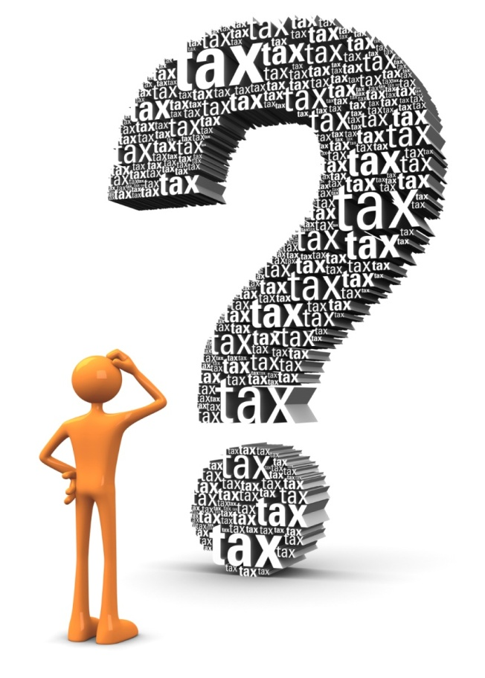
Check Point
If you were the lawmaker, would you treat capital gains as separate income or ordinary income?
Which similarities have you noticed in the participation exemption regimes of the different countries?
What is the participation exemption ratio?

Slide 17
LOSSES … main issues and possible solutions
The independence of each taxable period may be subject to limitations if a taxpayer has profits in one taxable year that could be offset by losses from different taxable years… to what extent can a taxpayer offset net operating profits utilizing the net operating losses?
1) it is possible to consider different taxable period as completely independent, thus not allowing taxpayers to carry back or carry forward net operating losses
2) it is possible to allow taxpayers only to carry back or only to carry forward net operating losses
3) it is possible to allow taxpayers both to carry back and carry forward net operating losses
Most countries choose to allow taxpayers to carry back or carry forward net operating losses. The reason behind this is that taxpayers with losses would be excessively penalized if they could not offset profits from one taxable period with losses from another

Slide 18
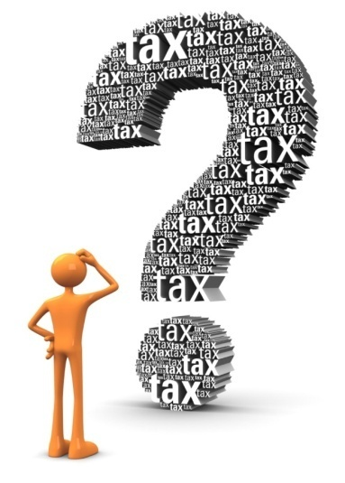
Check point
Can you imagine whether the loss issue may pose vertical equity and horizontal equity issues?
To answer this question, let us assume that the taxpayer A realizes a loss in year (n) of € 100.000 and a net profit in year (n + 1) of € 5.000
It would be reasonable to treat the above mentioned taxpayer A differently from taxpayer B that realizes a loss of 95.000 in year (n) and zero income at the end of year (n + 1) ?
It would be reasonable to tax A on the € 5.000 in year (n + 1) despite his inability to pay?

Slide 19
The solutions adopted by the countries
In Germany, In general, losses up to EUR 1 million may be carried back to the preceding 2 years. Any excess losses may only be carried forward to be set offmagainst the first EUR 1 million of net income in a given year without restriction; any remaining loss may be set off against up to 60% of the net income exceeding this limit.
In the UK trading losses may be set off against the company’s other taxable profits (if any) and chargeable capital gains of the same accounting period. Trading losses may also be carried back for 1 year.
In Italy losses may be carried forward indefinitely, but cannot be carried back. However, losses carried forward may not be used to offset more than 80% of the taxable income in any tax year A specific rule applies to losses accrued during the first 3 years of business. These losses may be carried forward without limitations and set off in full against taxable income of any subsequent tax year, provided that the losses originate from a new activity, i.e. an activity that was not previously carried on by another person.
In France, Losses may be carried forward indefinitely. Corporate taxpayers also have the option, with certain restrictions, to carry back losses for 1 year to set them off against the previous year's profits up to EUR 1 million, in which case they are entitled to a tax credit equal to the tax previously paid on the corresponding profits.
In Spain losses may be carried forward indefinitely. No carry-back of losses is permitted.

Slide 20

Check-Point
So, which country/countries does/do allow the most favorable regime to carry forward losses?
And which country/countries does/do prevent from carrying back losses?
Do you think that special rules should be provided for new activities/start-up companies?

Slide 21
Depreciation and
Amortization in Germany …
Depreciable assets are fixed assets used in the production process which diminish in value over time and have a useful economic life of over 1 year). Depreciation is compulsory and must take place whether the company is profitable or whether it incurs losses. The depreciable base of an asset acquired for consideration or produced by the taxpayer is its cost.
Before 1 January 2008, the normal methods of depreciation for movable fixed assets were the straight-line method, the declining-balance method and the production method. They could be used alternatively, provided the required conditions were met. A change from the declining-balance method to the straight-line method was permitted, but not vice versa.
For movable fixed assets, a general table issued by the Federal Ministry of Finance applies, giving the asset depreciation range, i.e. the number of years over which the asset is written off.
Land is not depreciable.

Slide 22
Accelerated depreciation
Accelerated depreciation may be taken instead of ordinary depreciation in respect of renovation of buildings. Accelerated depreciation up to 9% is available in the year of renovation and in the following 7 years, and up to 7% in the following 4 years.
For companies with net assets of not more than EUR 200,000, an additional depreciation of up to 40% (20% for assets produced or acquired before 1 January 2024) of the cost of acquisition or manufacturing of new movable assets is granted in the year of acquisition or manufacturing and the following 4 years (40% for all years together), provided they remain in a domestic permanent establishment or have rented it out for at least 1 year.

Slide 23
…Spain …
Depreciation is allowed in respect of all tangible fixed assets (except land) and intangible fixed assets on the basis of their normal useful life . Depreciation may be calculated in accordance with the straight-line method, the declining-balance method (excluding buildings, furniture and fixtures) or the sum-of-the-years'-digits method. Rates for depreciation are contained in official tables.
Depreciation applies from the date the underlying asset enters into effective service and it must be calculated on each separate asset and not on groups of assets unless these are attached to specialized complex installations. There has been a simplification of the amortization/depreciation tables.
Under the straight-line method, both the minimum and the maximum rate are fixed
Under the declining-balance method, the annual depreciation rate is increased by a certain percentage from 50% to 100% (depending on useful life)

Slide 24
Other methods
The tax authorities may accept, at their discretion, special depreciation plans with higher annual rates of depreciation for new assets subject to an effective depreciation greater than the one calculated at normal rates. Certain types of assets, e.g. assets used in research and development activities (except for buildings qualifying for accelerated depreciation over 10 years), may be freely depreciated. In addition, free depreciation is allowed for investments in new property, plant, equipment and investment properties used for economic activities, among others.
Intangible fixed assets may be depreciated over their useful life. For unlimited-life intangibles, including goodwill, the time limit is 20 years

Slide 25
France
Depreciation is generally allowed in respect of tangible assets (except for land) which are subject to normal wear and tear and do not qualify as inventory items. Intangible assets which do not irreversibly diminish in value, e.g. goodwill and trademarks, are not depreciable. However, the depreciation of certain specific intangible assets such as patents, software and shares in certain companies is allowed. Start-up costs may be either deducted as operating expenses or depreciated over a 5-year period.
For investments in qualifying industrial, manufacturing and scientific research equipment that are made between 15 April 2015 and 14 April 2016, the taxpayer may increase the usual amortization base by 40% (i.e. the investment will be amortized on 140% of its cost) → Italy copied such an incentive method in 2015
A similar incentive is introduced with effect from 1 January 2019 for investments in robotics and digital tools made by SMEs to improve their industrial manufacturing processes, as well as for investments in environment-friendly trucks and ships

Slide 26
Italy
Depreciation of tangible assets is permitted on a straight-line basis. In particular, depreciation is determined by applying the coefficients periodically established by the Minister of Finance to the cost price. These coefficients vary depending on the type of property and the sector of activity (rates for buildings vary between 3% and 5%, for plant and machinery, and equipment between 10% and 40%). Land is not depreciable.
Tangible property with an acquisition cost less than EUR 516.46 may be written off in the current year (simplification ratio)
Depreciation of vehicles that are not:
directly used for the business proper of the company; or
put at the disposal of the employees for the greater part of the fiscal year is only allowed up to 20% of the maximum value.

Slide 27
Check Point
Why do Countries rule the amortization regime for tax purposes?
Why do not Countries usually allow land amortization?
Can amortization be used as tax advantage?
Can you do some examples, according to the previous comparison?

Slide 28
Patent box
A ‘patent box’ is a tax incentive which provides relief from corporate tax on income generated from certain types of qualifying intellectual property (IP), particularly patents. Patent boxes are distinct from other tax incentives such as research and development (R&D) tax credits. R&D tax credits are provided at the front end of the innovation lifecycle, in the years when research and development expenditures are incurred. The benefits are generally given as a proportion of expenditure on qualifying activities, often in the form of a “super-deduction” against other taxable profits. R&D tax credits therefore act to encourage specific R&D activities designed to result in innovation. In contrast patent box regimes provide tax relief at a later stage of the innovation lifecycle, in the years when income is generated from exploiting IP. Relief can be given either as a reduced tax rate or a deduction for a portion of the patent box income.
Intellectual property (IP) is highly mobile and can be easily moved from the jurisdiction where it was developed to low-tax jurisdictions. Over the last few decades, governments have seen that a greater proportion of IP (and the resulting revenue stream) has been moved offshore to minimize tax. The primary aim of governments who have introduced patent box regimes is to reduce or reverse this trend, and to encourage businesses to hold IP in their jurisdiction instead

Slide 29
Italy
Italy introduced an optional taxation regime for income produced by intangible assets, known as the ‘Patent Box’→ the regime allows taxpayers to exclude a percentage of their income derived from certain intangible assets from their tax base.
Resident and qualifying non-resident persons deriving business income in Italy may opt for a patent box regime, provided that they either directly carry on R&D activities aimed at creating and developing qualifying intellectual properties or outsource them to universities, research institutions or equivalent entities, or unrelated companies.
The election is valid for 5 tax years and cannot be revoked, but it can be renewed.
Under the patent box regime, the amount of qualifying R&D expenses, relevant for corporate taxation purposes, is increased by 110%.
Qualifying R&D expenses are those related to copyrighted software, patents, designs and models used directly or indirectly by the taxpayer to carry on its business activity.
Italy repealed its patent box in 2021 and instead introduced a deduction for 230 percent of costs related to research and development. This represents a transition away from a benefit based on income (the patent box) to a benefit focused on investment or expenditure (the super-deduction).

Slide 30
UK
Under the patent box regime, corporation tax relief is given via a deduction in the calculation of trading profits for the relevant accounting period. Broadly, the deduction is of an amount equal to the company’s relevant intellectual property profits (RIPP).
The legislation sets out detailed and formulaic rules for calculating the RIPP.
The deduction has effect as if a 10% rate were applied to the relevant profits. As such, the legislation refers to a “lower rate”, applicable to profits falling within the regime.
The relief was phased in for financial years 2013, 2014, 2015 and 2016. Full relief is granted with effect from financial year 2017.
In 2016, amendments to the patent box regime were introduced to ensure compliance with OECD recommendations.

Slide 31
Spain
In Spain, A partial exemption applies to the net earnings derived from the assignment of a right to use qualifying intangible fixed assets. Under this incentive, 60% of such income is exempt from corporate income tax.
With effect from 1 January 2018, the patent box incentive was amended to bring it in line with the “modified nexus approach” as contained in Action 5 of the OECD's Base Erosion and Profit Shifting initiative. From that date, the above-mentioned 60% exemption still applies, but the determination of the income to which that percentage applies has changed.
Several conditions apply, including, inter alia:
- the assignee may not reside in a non-cooperative jurisdiction or zero-tax territory; and
among related entities, the assignee must use the asset rights in the pursuit of an economic activity that does not generate
tax-deductible expenses for the assignor.

Slide 32
France
With effect from 1 January 2019, a new tax regime in line with the OECD’s modified nexus approach was introduced for income from industrial property. The income benefiting from this regime is taxed upon election at a favourable 10% rate. This optional regime replaced the former specific rate of 15%, which was applicable to such income regardless of any nexus condition
The new regime applies to the income derived from the licensing, sublicensing or sale of patents, plant variety rights, industrial manufacturing processes, copyrighted software or (for SMEs only) patentable but not patented inventions (“qualifying income”).
Expenses relating to these assets (“qualifying expenses”) must be deducted from the qualifying income to determine a net result, to which a nexus ratio must be applied to determine the effective result that may benefit from the 10% rate

Slide 33
Germany ?
Germany has never introduced a proper patent box regime. The government has repeatedly said it would consider introducing so-called patent boxes if there were no progress towards fair tax competition at a global level

Slide 34
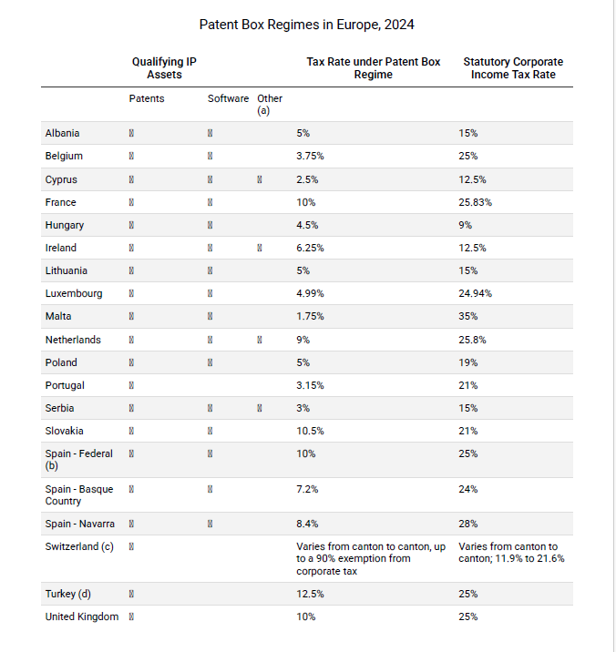
Patent box regime in 2024 (https://taxfoundation.org/)

Slide 35

Check Point
Why do countries introduce patent box regimes?
Among the jurisdictions involved, which one does seem to provide the most convenient patent box?
Is it compliant with European law?

Slide 36
Regional development incentives … France
Redevelopment areas
A 5-year tax exemption is granted to companies created in certain redevelopment areas by 31 December 2017, i.e. in areas with a declining population and a high unemployment rate. The overall reduction of taxes (not of the tax base) pertaining to this regime cannot, however, exceed EUR 200,000 over a 3-year period.
Corsica
A tax credit is available for certain business investments made in Corsica by small and medium-sized enterprises (SMEs) if such investments are made before 1 January 2021. Various conditions apply to qualifying SMEs and investments. The credit is equal to 20% of the cost or the acquisition price of qualifying investments. The credit may be set off against the corporate (or individual) income tax due by investors in the assessment year in which the investment is made.
Urban tax-free zones
Enterprises created before 1 January 2024 in one of the specified economically disadvantaged urban and suburban zones are eligible for various tax incentives, including a 5-year corporate income tax exemption. The totalamount of income so exempt, however, it cannot exceed EUR 50,000 in any 12-month period.

Slide 37
Spain
Companies that are registered with the Official Registry of ZEC Entities (Canary Islands Special Zone regime) before 1 January 2013 may benefit from a special tax regime designed to improve the economic conditions of the Canary Islands. The ZEC regime will initially apply until 31 December 2019 (registration closed on 31 December 2013), although further extensions may be granted.
Such companies must have their legal seat and place of effective management in the geographical area of the ZEC. At least one of the managers of the ZEC company must be resident in the Canary Islands.
A qualifying company may benefit from a reduced corporate income tax rate of 4%. The maximum taxable base to which this reduced rate applies depends on the number of jobs created by the company

Slide 38
Basque country and Navarre
In the area of the Basque country, several tax incentives are granted including a corporate income tax rate of 28%. Small companies in Alava, Vizcaya and Guipúzcoa are subject to a rate of 24%.
In Navarre the general corporate income tax rate is 25% and the reduced rate for small and medium-sized companies is:
-23% if the company’s net revenues were between EUR 1 million and EUR 10 million in the previous year (under conditions); and
-19% if the company’s net revenues were lower than EUR 1 million (under conditions)

Slide 39
Italy
Qualifying companies, including companies operating in the agricultural, forestry, fishery and aquaculture sectors, may benefit from a tax credit for investments made in certain new business assets purchased, or acquired through a financial lease, until 15 November 2025 to be used in productive facilities located in the ZES unica, which includes the regions of Abruzzo, Basilicata, Calabria, Campania, Molise, Puglia, Sardinia and Sicily.
The amount of tax credit varies depending on the relevant region and project's costs.

Slide 40
Reshoring of business activities
A 50% exemption from corporate taxation applies to income derived from business activities transferred to Italy from a non-EU/EEA jurisdiction, unless the transferred activities had already been carried on in Italy in the 24 months preceding the transfer
The incentive applies in the tax year of the transfer and the following 5 tax years. However, a recapture mechanism applies if the business activity is, also only partially, re-transferred abroad during the period of application of the incentive or within 5 tax years (10 for large enterprises) following its expiration.

Slide 41
And individuals?
Italy has introduced some new rules to attract non-resident individuals in Italy.
The “Ronaldo regime”: Non-resident individuals transferring their tax residence to Italy after residing abroad for at least 9 of the previous 10 tax years are entitled to opt for a special tax regime for a maximum of 15 years. If they opt for the tax regime, they are required to pay a lump-sum substitute tax of EUR 200,000 (EUR 100,000 for individuals transferring their tax residence before 10 August 2024), and additional EUR 25,000 for each qualifying relative, in each year, in lieu of ordinary taxation on their foreign income, except capital gains on substantial participations realized within the first 5 tax years of exercising the option.
However, qualifying individuals may opt to exclude from the application of the regime foreign income arising in one or more countries, in order to apply the general tax rules and benefit from the applicable treaty relief. They are still required to pay ordinary income tax on Italian income
The retired regime: non-resident individuals earning foreign pension income and transferring their tax residence to small municipalities of certain regions in the south of Italy or to certain municipalities affected by the earthquake of 6 April 2009, after residing abroad inthe previous 5 tax years, are entitled to opt for a favourable regime for a maximum of 10 years. If they opt for the tax regime, they are required to pay a 7% substitute tax on their foreign income

Slide 42
… attracting expatriate individuals
The researchers regime: In order to promote the immigration of scientists into Italy, employment or self-employment income of lecturers and researchers who have been working abroad for at least 2 years and start working in Italy, becoming resident in Italy for tax purposes, is exempt for 90% from IRPEF. The benefit applies in the tax year in which the Italian tax residence is acquired, and in the following 5 tax years (or more if certain conditions are met).
Inward expatriates: Individuals transferring their tax residence to Italy on or after 1 January 2024 may benefit from a 50% exemption of their Italiansource employment and self-employment income up to EUR 600,000, provided that the following conditions are met :
they commit to maintaining their residence in Italy for at least 4 years;
- they were not resident in Italy in the 3 years preceding the transfer. However, if they are employed with the same employer they had before the transfer, or with an employer of the same group, the required period of residence outside of Italy is increased to 6 or 7 years, depending on the specific circumstances;
- they are mainly working in Italy; and
- they qualify as highly skilled or specialized workers, as defined by law.
Subject to certain conditions, the exemption may be increased to 60%. The favourable regime may apply for 5 consecutive tax
years starting from the tax year in which the individual transfers their tax residence, and cannot be extended beyond this period

Slide 43
Check Point
Why do many Countries provide regional incentives?
Why do Countries provide special regime for attracting non-residents or expatriates?
Do you think such rules represent a fair tax
competition ?

Slide 44
Other incentives …
Tonnage tax (special beneficial regime for shipping) do exist in Germany, UK, Italy, France and Spain
Research and development relief exist in most the countries (UK, Italy, France, infra more in detail)
Special regime for innovative new companies is provided both in Italy and France (infra, more in detail). In Spain a special regime is granted to newly created companies

Slide 45
References for Comparative Tax Law
V. Thuronyi, K. Brooks, B. Kolozs, Comparative Tax Law, Kluwer Law International, 2016;
R. S. Avi-Yonah, G. Inbar, O. Marian, L. Mello, Comparative Tax Law: Theory and Practice, Bull. For Int. Tax., 2010, p. 183;
C. Sacchetto & M. Barassi (eds.) Introduction to Comparative tax law, Rubbettino Editore, 2008;
J. e. D’Auvegne (et al. eds.) Global Individual Tax Handbook, IBFD, 2015;
J. e. D’Auvegne (et al. eds.) Global Corporal Tax Handbook, IBFD, 2015;
H.J. Ault & B.J. Arnold, Comparative income taxation, a structural analysis, Kluwer Law International, 2010;
P. Adonnino, La pianificazione fiscale internazionale, in Dir. Prat. Trib., 2008, 3, p. 481;
R. S. Avi-Yonah, N. Sartori, O. Marian, Global Perspectives on IncomeTaxation Law, Oxford Un. Press., 2011;
C. Garbarino, An Evolutionary and Structural Approach to Comparative Taxation: methods and Agenda for Research, 57 American Journal of Comparative Law, 2009, p. 677
https://taxfoundation.org/
IBFD Country research Platform

