Slide 1
International Tax Law
Module I
Prof. Lorenzo del federico

Slide 2
OUTLINE
Why this course?
What is international tax law?
What is European law?
What is Comparative tax law?
Why do we need such a set of rules?
What is tax planning?

Slide 3
INTRODUCTION
TERMINOLOGICAL ISSUES AND KEY DEFINITIONS

Slide 4
Our Class
We will analyze some legal instruments for tax planning → The tax factor plays a pivotal role on business choices: tax burden, obligations and undertakings, relationships with Tax Authorities influence investments and business location
→ We will study international tax law, comparative tax law and EU tax law in the perspective of tax planning
What is tax planning? Tax planning is when a taxpayer makes use of the tax law to pay the least amount of taxes possible. It is important to underline that - unlike tax evasion, tax avoidance and fraud - tax planning is not unlawful
So what we are talking about is licit tax saving. It is common knowledge that the definition of tax evasion, tax avoidance and licit tax saving is debated by academics and it is not clear where the distinguishing line should be drawn.
Moreover, the nature of each of this concepts varies from country to country depending on government’s policies, court decisions, tax authorities 'attitudes and public opinion (e.g. each jurisdiction has its own tax avoidance policies and rules and therefore the same transaction could be classified as legal in one jurisdiction while simultaneously regarded as illegal in another)

Slide 5
Tax planning definition
Despite this obscurity, we can nevertheless define licit tax saving or tax planning as commonly accepted forms of tax behaviors that contradict neither the law nor its spirit and are intended to reduce the tax burden
Differences in the various tax systems represent the key for tax planning: international tax competition allows tax burden optimisation → tax rules contain provision favoring investments from foreign jurisdictions in a competitive context
Against this backdrop, we start to understand why comparing different tax systems is so important: comparison is the key for licit tax planning
Of, course, tax competition is reduced among States which are members of International Organisations aimed at promoting economic and political integration → European Union. This is the reason why we will also analyse some basic principles and rules of EU tax law which as a direct impact for EU Member States

Slide 6
Tax Evasion
What is tax evasion?
Tax evasion is illegal. It consist of the violation of tax rules.
Tax evasion or tax fraud is an illegal attempt to defeat the imposition of taxes by individuals, corporations, trusts, and others. Tax evasion often entails the deliberate misrepresentation of the taxpayer's affairs to the tax authorities to reduce the taxpayer's tax liability, and it includes dishonest tax reporting, declaring less income, profits or gains than the amounts actually earned, overstating deductions, bribing authorities and hiding money in secret locations.
Tax evasion is an activity commonly associated with the informal economy. One measure of the extent of tax evasion (the "tax gap") is the amount of unreported income, which is the difference between the amount of income that the tax authority requests be reported and the actual amount reported.
e.g. One way that people try to evade paying taxes is by failing to report all or some of their income. Sometimes people do not report income gained through illegal activities such as gambling and selling stolen goods.
Other times they do not report all the tips they collect or the money they earn through legal activities such as garage sales, baby-sitting, tutoring, or yard work. Such money-making activities are part of the underground economy, which exists as a way to avoid paying taxes.
If taxpayers fail to pay what officials say they owe, the Tax Authority can assess a penalty, in addition to collecting the back taxes.

Slide 7
Tax Avoidance
Tax avoidance is applying tax legislation in a way that inappropriately obtains a tax advantage. Tax avoidance can involve the misuse of tax reliefs and allowances or the re-characterisation of a transaction.
Tax avoidance involves transactions which are undertaken primarily to claim a tax advantage and not for genuine business reasons. Tax avoidance often involves contrived, artificial transactions that serve little or no purpose other than to gain a tax advantage.
Tax law is not violated such as in the evasion case but is bypassed
Penalties might be provided (some tax systems provide only administrative penalties but not criminal ones)

Slide 8
Examples
Let’s try to make this fundamental concept clear through some examples → no tax-related example
Let us imagine that the rule provides that ambulances do not pay a certain toll for access to a certain area.
an ambulance enters → lecit situation, comparable to legitimate tax saving
a vehicle that is not an ambulance enters without paying, but it is painted and camouflaged to make it look like an ambulance → fraud/evasion
an ambulance enters but is not in an actual emergency because the driver is using it as a normal means of transport → it is comparable to avoidance as we do not have an infringement of law but its purpose is bypassed

Slide 9
International Tax Law
Given that our focus is tax planning, let’s try to fix some basic definitions…
“International law of taxation” refers to the set of rules governing the taxing power of individual States which stem from sources of international law. An example of norms belonging to this category would be the international conventions against double taxation, which are generally bilateral agreements and, among the sources of international law, fall under the heading of treaties.
“International tax law”, strictly speaking, instead refers to the set of domestic rules governing the tax treatment of cases that cross national borders. An example of this category would be the domestic rules governing taxation of foreigners.
In brief, the distinction is based on the nature of the source: “domestic” in international tax law and “international” in international law of taxation. In practice, however, the preference is often to adopt a single term for international tax regulations, merging these two distinct categories into what is known as “international tax law”.

Slide 10
Is international tax law a bluff?
We are already beginning to understand - and we will see this more clearly in the course of our lectures - that the reference remains ‘domestic law’. We must imagine international law as an empty box that is filled with content through the rules of domestic law
International law establishes criteria for allocation between different states.
For example: a resident in Italy does a work in Spain
International tax law determines whether the power to tax lies with Italy or Spain.
But then, once the state with taxing tights has been identified, domestic rules provide the taxation regime

Slide 11
And EU Tax Law?
European law - beyond the features we will see - is concerned with taxation but only in order to protect fundamental EU freedoms
Here, too, we will see that much of the tax rules lie in domestic law, even if interpreted in the light of fundamental EU principles
The rules set at European level are still relatively limited: VAT itself - a fully harmonised tax for all intents and purposes - for a large part of the concepts and institutes devolves to domestic law
e.g. the right of deduction is a key institution of the VAT system → we will see that the entire set of rules is domestic even if in the background it must be interpreted in the light of European principles (e.g. principle of neutrality)

Slide 12

International Tax Examples
In Country A, the tax rate for individuals with an income up to € 80,000 is 40%.
In Country B, the rate for individuals with income up to € 80,000 is 15%.
Mike resides in Country A and would like to pay less tax.
Mike actually moves to Country B → lecit tax saving, tax planning
Mike enters into a fake lease and pretends to move to Country B. Actually, he continues to live in Country A → tax fraud, evasion as the transfer of residence is fake
Mike enters into an actual lease agreement and…
Try to identify some elements for the case of tax avoidance

Slide 13
Raising the difficulties… an actual case of international tax avoidance
Double Irish-Dutch Sandwich
US Parent company transfers IP to IP Holding
IP Holding is double resident in Carribbean State and in Ireland with management in Carribbean State
IP Holding is not taxable in Ireland according to Irish Tax rules:
because management is in Carribbean State;
the shareholder are resident in US;
IP Holding controls an Irish company with active business.
For US purposes IP Holding is Irish company because founded under Irish law
We have also another Irish company which is an active company
IP Holding gives general license to inactive NL company;
NL company gives license to active Irish company
Flow of license fees therefore: operative company → active Irish company → inactive NL company → IP Holding → no dividend distribution to US Parent

Slide 14
Effects
Ireland has no anti-abuse rules
• Flow of Royalties:
Royalties in state of operating companies are deductible
Royalties are not subject to withholding tax
Royalties from NL to IP holding not subject to withholding tax since NL do not levy tax on royalties
Such a “triangulation” makes it possible to take advantage of Ireland's particularly advantageous tax regime (12.5% tax rate), taking away from the parent state (usually US) a large part of the income produced
This technique was actually used by Apple, Google, Facebook, LinkedIn, Zynga, PayPal, eBay …
Such a technique cannot be applied anymore as Ireland changed the residence rule in 2015. At the international level, States tried to find instruments to fight against international tax avoidance (we will see some of them: transfer pricing rules, anti-avoidance rule, minimum tax rates for multinationals…)
At the international level, tax avoidance creates both fairness issues (very low taxation of multinationals compared to other companies) and problems of proper allocation of taxing power between States → the idea is that taxation should take place in the state where the value is created

Slide 15
Check-point
What is Tax Evasion?
What is Tax Planning?
What is Tax Avoidance?
Try to make an example of the three different situations, thinking of a case of tax incentive

Slide 16
Comparative Tax Law
The Comparative approach: an overview

Slide 17
OUTLINE
The Comparative approach: an overview
Tax planning and comparative approach
The jurisdictions involved: key features
Germany
France
UK
Italy
Spain
Taxation on individuals
Corporate Taxation
Tax advantages for tax planning purposes

Slide 18
Comparative Taxation
Comparative taxation could be seen as a form of scholarly method of research and teaching
It obviously implies the justaxposition of tax laws of several jurisdictions but such a mere justaxposition is not in itself “useful” → to get a comparative tax knowledge we need new insights and conclusions that could not be achieved absent the process of comparing tax rules
The pivotal points revolve around three basic questions:
The purpose of comparative legal studies
The objects of comparative studies (which jurisdictions and which laws should be compared)
The techniques of comparison

Slide 19
Why comparing?
More and more tax practitioners are confronted with rules of foreign tax law. Of course it cannot be expected that an adviser is an expert not only in his domestic law but also in foreign tax law. But he must be able to ask his foreign colleague the right questions what supposes that at least he disposes over a general knowledge of the foreign tax system → necessity of studying foreign legal materials in our globalized world (tax, by its very nature, is an international field of practice)
Comparison leads to a better understanding of one’s own tax law
States based on different history, attitudes of populations, values and many other factors developed different types of tax systems, though many problems are the same or vey similar. To compare different answer to the same question or problem may not only bring about to a better understand of the effects of each solution (theoretical aspects), but also may help to improve the own system (de lege ferenda aspect) by adopting a foreign solution → comparative taxation in an instrument to advance, inter alia, successful tax reforms and legal harmonization
There is much benefit in studying tax policy because it will constantly and inevitably remain relevant, while the actual tax law are short lived. Tax policy is best understood through researching its implementation in practice, both locally and elsewhere → examining comparative policy choices is necessary not only to reveal the weakness of any local tax system but also to understand its areas of strength
Comparison leads to a possible legitimate tax planning: in general, the purpose of a comparative approach is to learn about new possibilities from studying actual practice (Thuronyi) and such “new possibilities” can develop tax planning → tax laws contain provisions favoring certain industries or activities, often with the avowed purpose of encouraging investment

Slide 20
The traditional scheme of legal comparison
According to a generalized scheme, legal comparison is a three phase process:
The descriptive phase in which the comparatist is expected to describe the norms, the concepts and institutions of the system concerned
The identification phase in which the comparatist identifies differences and similarities among the system studied
The explanatory phase in which the reasons for convergences and divergences are explained
→ Of course such a scheme must be filled with real contents: one must choose which jurisdictions to compare, which laws, which texts to read …→ there could be many different approaches (e.g. a functional approach, a cultural approach, an economical approach, a critical approach …) .. The possibilities of analysis can be multiple

Slide 21
The functional approach
The functional approach rests on the assumption that the legal system of every society faces essentially the same problems, and solves these problems by quite different means, though very often with similar results
Functionalists regard the convergence of legal systems as an inevitable and desirable phenomenon. Their comparative project is aimed at identifying the so-called “best legal solution” to a common social problem. These premises of functionalism are widely adopted among international and comparative tax scholars
When tax functionalists execute their comparative research, they might do so with the purpose of the harmonization of tax laws in mind (it is very common in the Eu context)
Functionalists premises suggest that a comparative legal researcher should start by identifying a particular practical problem and question in which is is solved in each of the jurisdictions compared (the problem-solving approach)

Slide 22
The economic approach
The economic approach starts with an assumption that “there is a competitive market for the supply of law”. It may be viewed as an offshoot of functionalism, which instead of simply asking which laws or institutions fulfill which functions, asks which do so in the most efficient way.
In essence, comparative economic research is aimed at inquiries into the deviations of different jurisdictions from an economically efficient benchmark: a so-called “model legal institution”
It is worth remembering the three economic principles of taxation:
Efficiency → the comparative search for the most efficient solution
Equity → the wealthier a person, the more taxes she should pay (vertical equity) → it is linked to the benefit principle (according to which the tax burden is proportionate to the benefits received by taxpayers) and to the ability to pay principle (not easy to define in brief, but we can just remember that as a taxpayers’ well – being increases, so does his ability to pay)
Simplicity → is not really an independent criterion, because unnecessary complexities waste resources (inefficiency) and cause a capricious assignment of tax burden (inequity), simplicity is usually measured by looking at compliance and administrative costs (the time and money spent by taxpayers to comply with the tax system and by the government to implement tax system)

Slide 23
The cultural approach
Cultural comparatists reject the functional assumptions of similarities of social problems and legal solutions. Rather, cultural comparatists assume that law is part of a broader cultural phenomenon. Each culture contains elements such as values, traditions, and beliefs, which give each culture its uniqueness. This “differentiation of cultures” involves that the laws (which are set in these cultures) are also necessarily different.
Consequently, it is not surprising that cultural comparatists reject harmonization projects, as they call for the annulment of cultural identity as expressed in the unique laws of a given society. They have long celebrated the virtue of “difference”
Even if harmonization was somehow desirable, cultural comparatists perceive it as an unattainable goal. Rather, according to this approach, comparative analysis should be aimed at understanding the cultural, social, political and, ultimately, the legal identities of “the other” (a cultural difference-oriented stance)

Slide 24
The critical approach
Critical scholars often see mainstream comparative law as a ideological project aimed at either assimilation or inclusion of other traditions, a process culminating in projects of harmonization
Instead, such scholars argue, comparative legal studies should be a “liberating project”, releasing us from the cognitive cage of abstract relativist dichotomies, which are wrongly perceived to be “objective”.
They see comparative taxation as a tool to “liberate” current discussion in international tax scholarship from its own “parochial” view

Slide 25
Methods of comparing tax law
Comparisons of tax systems as a whole are very popular. The main advantage of the comparison of statutory tax rates is that they are easy to calculate (it is sufficient to take into account the cumulative marginal tax rates levied on the profit or other items of taxable events). But is obvious that such a comparison gives little evidence of the reality because the tax rate tells only one half of the truth about a tax →the other half is the tax base and is influenced by various systems of calculating, tax benefits, loss compensations and other factors.
The scholars point out that the following considerations must be taken into account to if an international tax burden comparison should have any meaning:
All relevant taxes must be taken into account
All relevant provision for the determination of the base of taxation must be included as rules of depreciation, the capital gain taxes, valuation rules ..
The possibilities of inter-periodical loss compensation must be included
In the case of corporations the comparison can not be restricted to the taxation of the corporation itself, the interaction between the corporation and the income tax of the shareholder must be examined
The analysis must not be restricted to only one period as many effects are like only temporary
Effective tax rates can only be computed on the basis of a model with identical pre-tax data in a form of fictional assessment
E.g. the OECD has a different approach based on aggregated economic data from national accounts and shows the structure of taxation in OECD countries as percentages of the different taxes of the total revenues of the states. Such a structural comparison gives information about the amount of revenues in relation to the gross domestic product and it shows to which extent income tax and turnover tax contribute to the public budget → it is not a comparison of tax law

Slide 26
An OECD example: Tax burden on labor
The Organisation for Economic Co-operation and Development (OECD) reports data on the composition of the tax burden on labor across 38 developed countries.
The tax burden on labor is referred to as a “tax wedge,” which simply refers to the difference between an employer’s cost of an employee and the employee’s net disposable income. For the purpose of the OECD study, the wedge is determined by several factors: the amount of pre-tax income (referred to as “labor cost”) of a worker, the taxes that apply to that income, and whether the taxpayer is filing as single or as a family.
The OECD calculates the tax burden by adding together the income tax payment, employee-side payroll tax payment, and employer-side payroll tax payment of a worker earning the average wage in a country. The OECD then divides this figure by the total labor cost of this average worker, or what the worker could have earned in the absence of these three taxes.

Slide 27
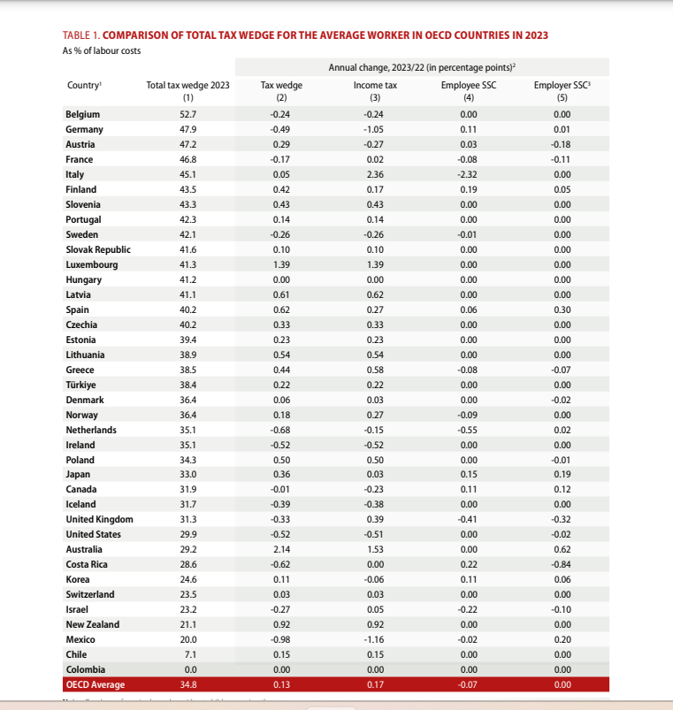

Slide 28
The possible classifications for comparing
Legal families: comparative law scholars divided countries into families to indicate broad similarities in legal traditions: Commonwealth family; American Family; French family; Latin American family; Transition and post-conflict countries; Northen European; Southern European; Japanese/Korean → it can impart structure to cross-country comparison and has significant implications for choosing which jurisdictions and tax laws to compare(e.g. Thuronyi suggests Germany, France, United States and UK as natural choices of tax comparisono because these countries can be regarded as leaders in influencing the tax law of other countries)
Classifying countries for purposes of tax policies analysis along economic lines could also be useful (e.g. generally speaking, tax represent a higher share of GDP in OECD countries than in non-OECD countries, although there is considerable variation within each group)

Slide 29

What about our research?
Purpose: analyzing convergences and differences in order to identify the most efficient solution (optimal tax burden) → legitime tax planning (which briefly may be defined as an arrangement of one's financial affairs to take full advantage of all eligible tax incentives, so that the tax burden is minimised in the hands of the taxpayer without violating the legal provisions) → we will follow, to a certain extent, a comparative law perspective in a problem-solving-oriented manner (a kind of economic –approach limited to a tax planning function)
Object: where several jurisdictions could be discussed, we will focus those with the more extensive literature in the EU context → German, France, Italy, Spain, United Kingdom
Tecniques: key features of the jurisdictions focused with special reference to the incentive measures … the point is “What kinds of incentives are in effect in the country?”

Slide 30
Aggressive Tax Planning & Tax Competition
Also in the OECD context, the same need is perceived → see the BEPS Action Plan (Base Erosion and Profit Shifting) → the OECD recognizes that fundamental changes are needed to effectively prevent double non-taxation, as well as cases of no or low taxation associated with practices that artificially segregate taxable income from the activities that generate it→ The G20 finance ministers called on the OECD to develop an action plan to address BEPS issues in a coordinated and comprehensive manner. Specifically, this Action Plan provides countries with domestic and international instruments that will better align rights to tax with economic activity → Therefore, the OECD promoted 15 actions in order to address the weaknesses in the current rules in an effective and efficient manner
Nevertheless, in the EU context different tax system still co-exist and the harmonization via for direct taxation has always been left open even if direct taxation can violate the fundamental freedoms of the EU Treaty
The approximation of different tax laws, regulations or administrative provisions of the Member States is provided in art. 115 TFEU, but actually the Member States keep their tax sovereignty in a context of potential competition

Slide 31
Check-point
Why can tax comparison be useful?
Which comparative approach do you think is more effective from a tax law perspective?
What about Tax Competition in the European Union?

Slide 32





The jurisdictions involved: key features
Germany
France
UK
Italy
Spain

Slide 33
Taxable Income
All the States involved adopt the source concept → it provides that a certain item is income only when it derive from a specific source, most likely an economic one
(vs the accretion concept adopted in the United States → a person’s annual income is the value of what it could consume in that year while keeping his wealth constant → ant realized accession of wealth is income unless it is specifically excluded)
All the States involved define income in a schedular way → income is taxable only if there is a specific “sheduled” source for such income (e.g. in Italy, the realized capital gain on the private sale of a piece of art is not taxable, since it is not listed under any particular “schedule”)

Slide 34
The taxpaying unit
Every country with and individual income tax system faces the definition of a taxable unit for purposes of linking the taxable income to a specific subject. There are two main models to define taxable units:
Under the individual model (or separate taxation model) , each physical person is a taxable unit; therefore everyone has to file tax returns, declare taxable income, claim expenses and deductions and pay income taxes.
Under the family model (or joint assessment model) the family is the taxable unit, and each individual is treated as a part of his family; the family is thus required to file a tax return, declare income …
Of course, the definition of taxable unit brings in several equity and efficiency considerations (horizontal equity, redistributive perspective, the so called “marriage penalty or marriage bonus)
The individual model is adopted by Italy and UK, but both the systems grant a tax credit for ever dependent member of the family defined as a family member with no or limited taxable income
Germany has a hybrid model: the tax system allow taxpayers to elect to be taxed under the individual or the family model. Resident spouses living together are assessed jointly, unless they elect to be assessed separately. Income of children is not included in the taxable income of their parents but is taxed separately. Following a decision of the Federal Constitutional Court, the application of tax provisions relating to married couples was extended to partners registered under the civil law partnership regime (civil partners), with effect from 19 July 2013. From that date, civil partners may also benefit from a joint assessment.
France adopts the family model: the taxable unit is the family (husband, wife, dependent children and any other qualified disable persons who live with the family. Unmarried partners of the same or different sex may also qualify as a family for income tax purposes) → the income of all members of the family is aggregated and then split, based on quotient familial (a sort of “family share”) → the taxable income of the household is divided into shares equal to the number of family members

Slide 35
Global and Territorial Model
From the perspective of a single country, two issues should be dealt with 1) whether tax residents should be taxed on their worldwide income and 2) whether non residents should be taxes on the income sourced within the country
The solution to the above – mentioned issues gave rise to the mergence of two major models: the global jurisdiction and the source jurisdiction models
Global jurisdiction provides that the residence country has the right to tax its residents on their worldwide income → residents are taxed on both their domestic source and foreign source income. Non-redisents are taxed on their domestic source income (countries involved in our study)
Territorial jurisdiction provides that the residence country has the right to tax all persons (residents e nonresidents) only on domestic source income, meaning income derived within the country
→ residence and source are fundamental concepts to be defined

Slide 36
Individual Income Tax
German resident individuals are liable to income tax on their worldwide income and assets
The German Constitution and federal laws apply in the territory of the The income tax and the solidarity surcharge are imposed by the Income Tax Law ( Einkommensteuergesetz, EStG) and the Solidarity Surcharge Law ( Solidaritätszuschlaggesetz, SolZG). If an individual is engaged in a business, he is also subject to the Business Tax Law ( Gewerbesteuergesetz, GewStG
The taxable period is the calendar year. The income tax rate structure is progressive, up to a marginal rate of 45%

Slide 37
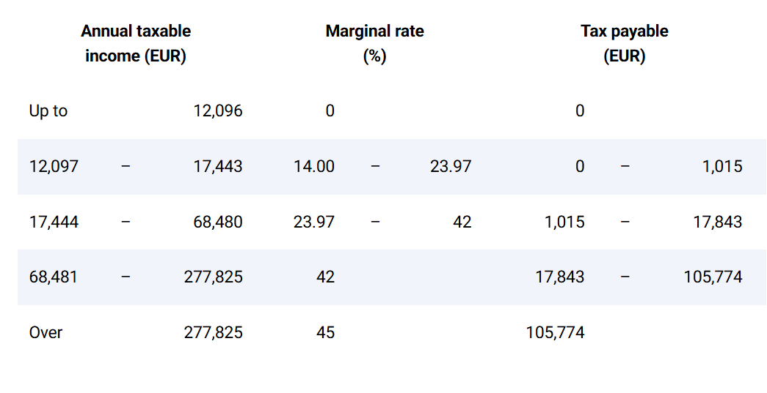
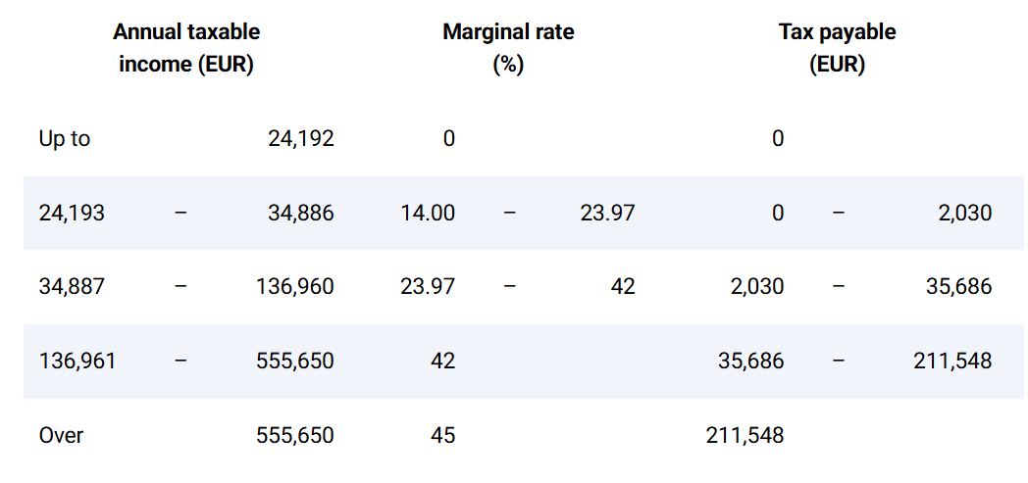
A comparison
Single taxpayers
Jointly assessed spouses or civil partners

Slide 38
Taxable income
Resident individuals are subject to income tax on their worldwide income falling under one or several of the following categories :
(1)income from agriculture and forestry;
(2)income from a trade or business;
(3)income from independent personal services;
(4)income from employment, including compensation from past employment;
(5)income from capital investment;
(6)rental income from immovable property and certain tangible movable property and income from royalties; and
(7)other income (gains from private transactions, alimony, annuities, etc.).
Each category has its own special rules for computation and determining the base of the income tax assessment
The amounts of taxable income of all categories (calculated as stated above) are aggregated. The aggregate income, less personal deductions, is the taxable base to which the allowances and rates are applied

Slide 39
Residence/domicile
Residents are liable to income tax on their worldwide income. Non-residents are generally liable to this tax on certain German-source income
An individual is, regardless of his nationality, a resident of Germany if his domicile or habitual place of abode is in Germany. A domicile is a home or dwelling at the disposal of the taxpayer and maintained long term. A habitual place of abode is a location where an individual is physically present for a continuous period of more than 6 months (short interruptions are not taken into account).

Slide 40
Individual Income Tax
For income tax and capital gains tax purposes, the United Kingdom comprises England, Wales, Scotland, the six counties in the north-east of the island of Ireland, commonly known as Northern Ireland, and the United Kingdom’s continental shelf. It does not include the British Channel Islands of Guernsey and Jersey, or the Isle of Man
Taxable persons comprise resident individuals and trusts. Non-resident individuals and trusts are taxable on their UK-source income.
Before 2013-14, there was no statutory definition of residence. Finance Act 2013 introduced a so-called Statutory Residence Test (SRT), which took effect from 6 April 2013.
Three sets of tests in determining the residence status of an individual are provided. There are four automatic UK residence tests, five automatic overseas tests, and the “sufficient ties tests”. An individual who is found to be UK resident under the SRT will normally be treated as resident for the full tax year. However, the legislation provides for circumstances in which the tax year could be split.
The basic rule is that an individual is treated as UK resident if either the automatic residence test or the sufficient ties test is met. Otherwise, the individual is treated as non-resident.

Slide 41
The four automatic UK tests are broadly as follows:
1) presence in the United Kingdom for 183 days or more in a tax year;
2) having a home in the United Kingdom for all or part of a tax year, and, during the period when the individual has that home, there is a period of at least 91 consecutive days when either (i) the individual has no home overseas; or (ii) the individual has a home (or homes) overseas, but spends no more than a permitted amount of time in that home
3) working sufficient hours in the United Kingdom over a period of 365 days without a significant break from work, and all or part of the 365 days falls within the tax year.
4) where the individual, having been treated as UK resident under one of the above automatic tests for each of the preceding 3 tax years, died while having a home in the United Kingdom. This rule is disapplied where the individual was overseas in the previous year in circumstances where split-year treatment was granted.

Slide 42
.. The other residence tests
The automatic overseas tests
The automatic overseas tests are five. Let’s make some examples:
1) where the individual spends fewer than 16 days in the United Kingdom, did not die during that tax year, and was UK resident for one of the preceding 3 tax years;
2) where the individual works sufficient hours overseas without a significant break from work….
The sufficient ties test
Where an individual meets none of the automatic UK tests and none of the automatic overseas tests, they will be treated as a UK resident if they have “sufficient ties” to the United Kingdom. The relevant ties depend on whether or not the individual was UK resident for 1 or more of the 3 years preceding the relevant tax year. The ties to be considered are family ties, accommodation ties, work ties, 90-day tie (broadly, presence in the United Kingdom for at least 90 days), and country tie (i.e. if the United Kingdom is the country in which the individual was present at midnight for the greatest number of days in that year). This will also apply where there is more than one such country where the taxpayer has spent the greatest number of days, and one of those countries is the United Kingdom

Slide 43

Residence in Spain
An individual is a resident of Spain for tax purposes if):
he stays in Spain for more than 183 days in any calendar year (the personal residence test); or
his centre of vital interests, i.e. his economic interests or business or professional activities, is in Spain (the economic residence test).
In the absence of proof to the contrary, a married individual is deemed to be a resident of Spain if the permanent home of his spouse and dependent minor children is in Spain.
Individuals who move their residence into Spain may opt to be taxed under this tax or the Spanish income tax on non-residents.
In addition, Spanish nationals who move their residence to a country deemed to be a non-cooperative jurisdiction (except for Andorra in certain cases) remain taxable on their worldwide income in the year of emigration and the 4 subsequent years.
Members of a family unit may elect for joint taxation

Slide 44
Income categories
Residents are liable to income tax on individuals (IRPF) in respect of their worldwide income;
Non-residents are liable to income tax on non-residents (IRNR) only on their Spanish-source income
The concept of income encompasses income from six basic categories according to the source or origin, namely employment income; income from movable capital; income from immovable capital; business income; capital gains; and imputed income
In particular: the category of imputed income → Income is imputed in the following cases: income from residences other than the taxpayer’s primary residence ; income under the fiscal attribution regime (where individuals are directly attributed the income from civil companies, joint ownerships or estates); income under the CFC regime; income from unit-linked insurance policies that do not fulfill certain legal requirements; and income from collective investment institutions established in listed tax havens

Slide 45

Residence in Italy
Resident individuals are subject to IRPEF on their worldwide income (article 3 of the TUIR). Non-resident individuals are taxable on their income arising in Italy
From 1 January 2024, resident individuals are those who, for the greater part of the tax year, including fractions of days, have their residence or domicile in Italy, or are physically present there. For these purposes, the term “residence” is defined in accordance with the Civil Code, while the term “domicile” is defined as the centre of the individual’s personal and familial relations, rather than their economic and professional interests.
Until 31 December 2023, resident individuals included also those who, for the greater part of the tax year, were registered in the Italian civil registry of the resident population. This registration is now a rebuttable presumption of residence, i.e. the burden of proof that the actual residence is outside Italy is in the hands of the taxpayer.
Similarly, Italian nationals are deemed to be resident in Italy if they emigrate to a jurisdiction which has a privileged tax regime, i.e. a jurisdiction included in the DM of 4 May 1999. Also, this presumption of residence is rebuttable.
Spouses are taxed separately on their earned income. Furthermore, each spouse is taxed on half the income of minor children, as well as on half the income generated by the assets owned in common by reason of the marital status and by the assets in a family settlement

Slide 46
Income categories
Resident individuals are subject to individual income tax on their worldwide income, which falls under any of the following categories:
-income from immovable property;
-income from capital;
-income from employment;
-professional income;
-business income; and
-miscellaneous income (redditi diversi), including capital gains.
Profits and losses are calculated separately for each income category. The aggregate taxable income is calculated by adding the income of each category; only losses arising from carrying on a business or exercising an art or profession may be deducted. Exempt income and income subject to a final withholding tax are not taken into account in determining aggregate income. Capital gains on the disposal of shares and other securities and on the transfer or redemption of debts or debt claims may be subject to a substitute tax that replaces the individual income tax.

Slide 47
The case of the taxation of works of art
To understand what the taxation according to categories actually meands, let’s make an example
The supply of a single work of art even of immense value - a painting by Van Gogh - does not fall under any of the six categories provided for by Italian law → If Marco, a natural person who is not an entrepreneur, sells the van Gogh painting and realises a capital gain of €10 million, he is not taxable because the case is not covered by the categories provided for by Italian tax law
This is a gap →the Italian lawmaker has provided that the transfer of works of art must be regulated but we are still waiting for the implementing decrees→ disposals of works of art will be taxed provided there is a speculative intent … then the issue will be to distinguish the cases in which a speculative intent exists

Slide 48
Residence in France
Resident individuals are persons who (regardless of their nationality):
have a home or, in the absence of any home, principal abode in France;
perform employment or independent services in France (unless such activity is only ancillary);
have the centre of their economic interests in France; or
are chief executives and directors of large French companies (i.e. companies with an annual domestic turnover exceeding EUR 250 million, including the turnover of related companies), unless they prove that they do not carry out their main activity in France.
Under article 23 of the Finance Bill for 2025 presented on 10 October 2024, the government proposed to clarify the fact that even if a person meets one or several of the criteria above (i.e. is deemed resident under domestic law), this person will not be considered a French tax resident if, under the provisions of international double taxation treaties, the person is regarded as a resident of another country.
The individual income tax (impôt sur le revenu) is imposed on the household rather than on each of the spouses separately. Separate assessments are made in exceptional cases only.

Slide 49
Income Categories
There is no comprehensive definition of taxable income. Generally speaking, taxable income is the total of the net results of each of the taxpayer’s income categories. The most important income categories are:
employment income (including income from prior employment);
business income;
agricultural income;
professional income (income from “non-commercial” activities, e.g. from the legal and medical professions and income from activities not classified into any other category);
income from activities performed by certain managers controlling family companies or limited partnerships;
income from immovable property;
investment income (income from movable property); and
capital gains.
The net result of each category is the gross income less the expenses incurred in acquiring or preserving the taxable income.
Income is first computed and adjusted according to each category’s own rules . Net results of all categories are then added up to form the gross aggregate income. Personal deductions and allowances are then applied to arrive at the net aggregate income. The income tax computed thereon is reduced by certain credits provided by law.

Slide 50

Check Point
Which Country does adopt a hybrid method, with respect to the taxable unit?
Which Country has four automatic residence tests?
What does the Italian anti – avoidance rule applying to people who moved to tax havens provide?
In depth
What are the pros and cons of an individual model with respect to the taxable unit?

